Slide 1
Service Point Placement By Customer Geolocation Clustering
By: Constantia Malekkou U214N2509
For: COMP592DL Project In Data Science
Supervisor: Dr Demetris Trihinas
At: University of Nicosia
On: May 2023

Slide 2
Service Point Placement By Customer Geolocation Clustering
Objective
Identify optimal placement for service points given that customers’ geolocation is known.
Why
Service providers can improve customer experience, minimize service times and distance to service points while potentially increasing their revenue

Slide 3
Literature Review
Maximal Covering Location Problem
To identify service points that would maximize population coverage over a desired service distance by locating a fixed number of facilities.
Desired Service Distance
The distance within which customers should be serviced
Fixed Number of Facilities
The cost related to opening and operating a new service point, including land acquisition, construction and/or renovation, and ongoing location maintenance and staff wages
Maximize population coverage
Various location solutions may exist for a given number of facilities. The optimal solution is the one that maximizes population coverage within the desired service distance for a fixed number of facilities
Church R, ReVelle C. The maximal covering location problem. Papers in regional science 1974; 32: 101-118

Slide 4
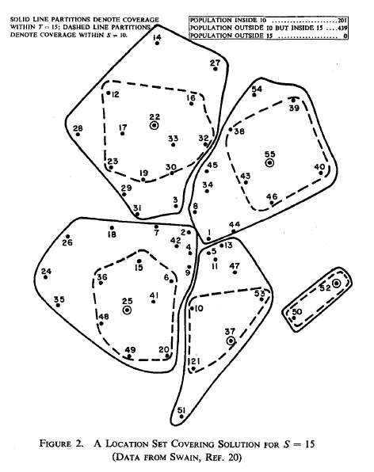
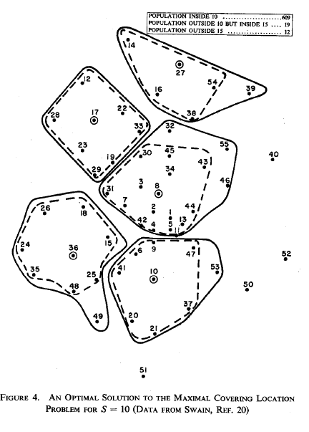
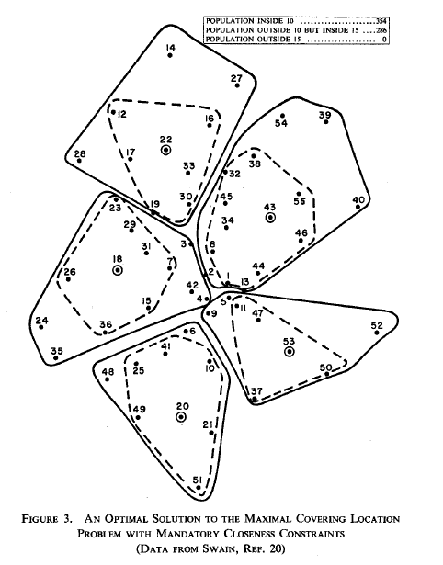
Maximal Covering Location Problem
Number of facilities: 5
Desired Service Distance S: 10
Maximum Service Distance T: 15
Population Covered within S: 201 (31%)
Population Covered outside S and within T: 439 (69%)
Population Not Covered (outside T): 0
Number of facilities: 5
Desired Service Distance S: 10
Maximum Service Distance T: 15
Population Covered within S: 354 (55%)
Population Covered outside S and within T: 286 (45%)
Population Not Covered (outside T): 0
Number of facilities: 5
Desired Service Distance S: 10
Maximum Service Distance T: 15
Population Covered within S: 609 (95%)
Population Covered outside S and within T: 19 (3%)
Population Not Covered (outside T): 12 (2%)
Church R, ReVelle C. The maximal covering location problem. Papers in regional science 1974; 32: 101-118

Slide 5
Distance as Quality of Service
Assumptions
All service points provide the same service to customers
Customers are serviced by their nearest service point
Quality of Service is a function of the distance to the nearest service point
Eiselt HA, Marianov V. Gradual location set covering with service quality. Socio-economic planning sciences. 2009 Jun;43(2):121-30
Location, Location, Location
When Distance, Distance, Distance Matters

Slide 6
Service Point Placement By Customer Geolocation Clustering
Initial Population
List of registered legal entities and their registered office addresses through the CY Open Data Portal
Address Text-To-Geolocation
Google Maps Geocoding API to geocode the text addresses
Method
k-Means Clustering on geolocations
Result
Optimal Service Point Number and Locations for the sample population
Evaluation
Comparison of the model’s results against the existing service point placement of two competitor service companies

Slide 7
Initial Population
Address Preprocessing
Customer Preprocessing
Total Initial Addresses | 178.916
Unique Initial Addresses | 124.297
Total Geocoded Addresses | 115.191
Unique Geocoded Addresses | 79.894
Total Initial Customers | 509.647
Total Filtered Customers | 238.725
Filtered Customers with Geocoded Addresses | 218.738
Filtered Customers with Geocoded Addresses within Cyprus Geocoordinates | 217.788

Slide 8
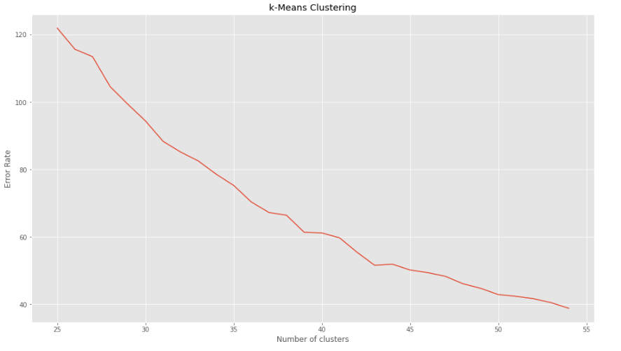
k-Means Clustering
Number of clusters
The number of distinct clusters of geolocations
Error rate
Sum of squared distances to the cluster centroids
“Elbow” point
The point when the marginal gains in error rate reduction start diminishing, indicating that the cost-effectiveness of adding more clusters is also reduced
37

Slide 9
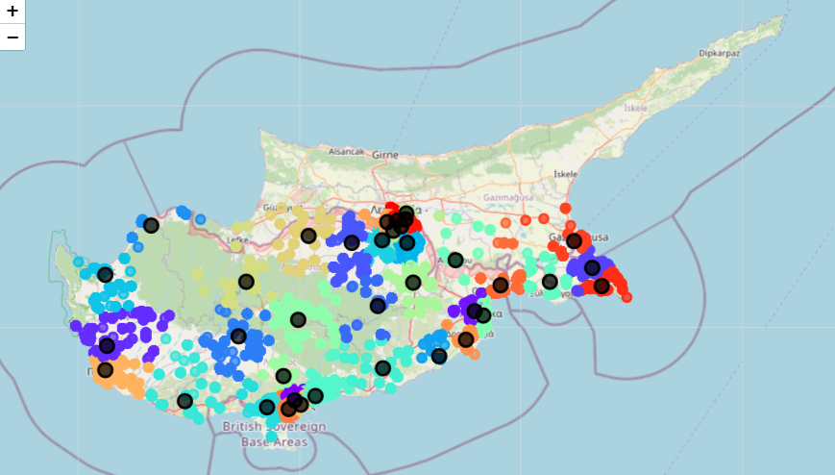
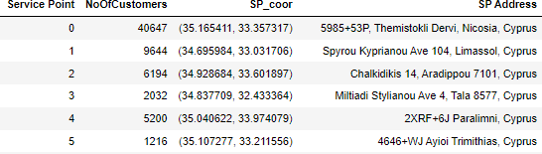
k-Means Clustering Results Overview

Slide 10
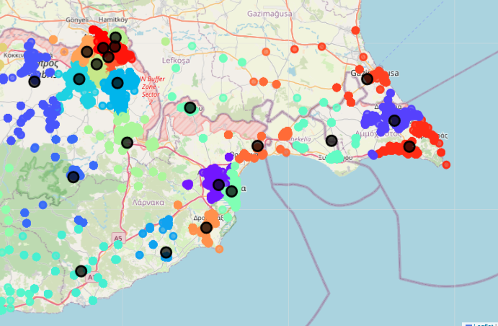
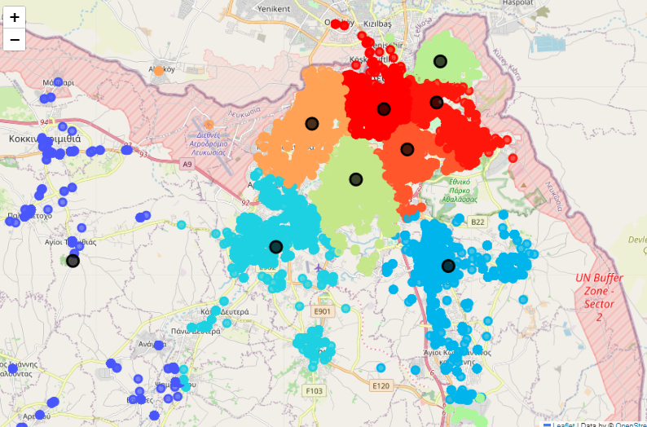
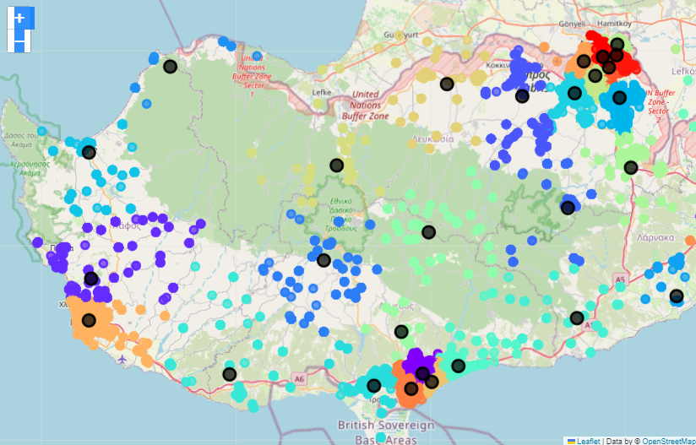
k-Means Clustering Results Detail

Slide 11
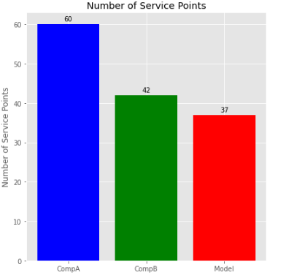
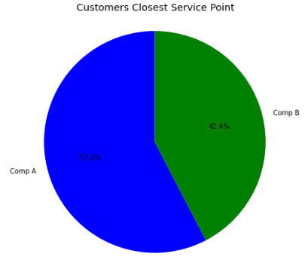
Initial Service Points
 | Number of Service Points
Comp A | 60
Comp B | 42
Model | 37
 | Number of Customers | Percentage
Comp A | 125.520 | 57,6%
Comp B | 92.268 | 42,4%

Slide 12
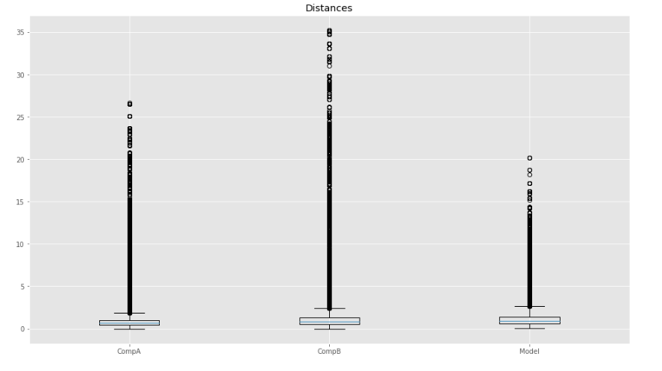
Distance to Nearest Service Point
Distance

Slide 13
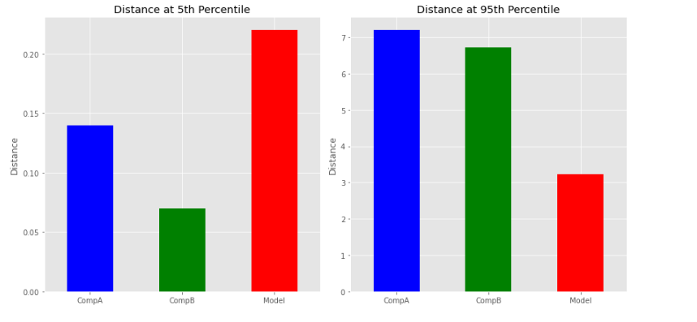
Distance to Nearest Service Point
(5th and 95th Percentile)

Slide 14
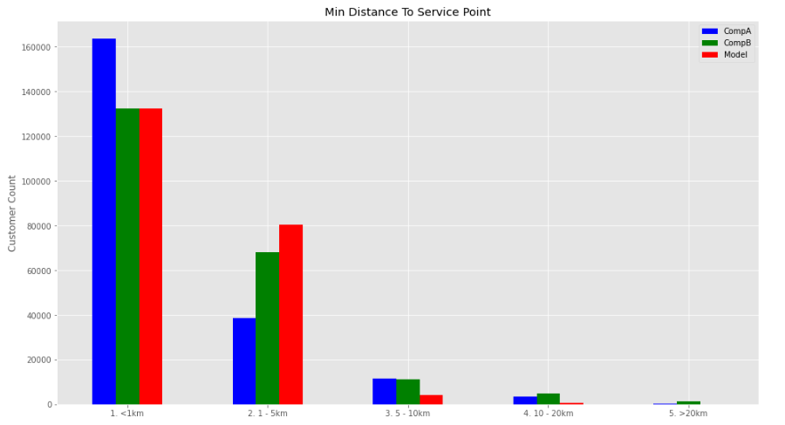
Distance to Nearest Service Point Group
Distance Group | CompA |  | CompB |  | Model
 | N | % | N | % | N | %
<1 km | 163.600 | 75,12% | 132.461 | 60,82% | 132.432 | 60,81%
1-5 km | 38.705 | 17,77% | 68.108 | 31,27% | 80.455 | 36,94%
5-10 km | 11.593 | 5,32% | 10.992 | 5,05% | 4.267 | 1,96%
10-20 km | 3.531 | 1,62% | 4.824 | 2,21% | 631 | 0,29%
>20 km | 359 | 0,16% | 1.403 | 0,64% | 3 | 0,00%
Total Customers | 217.788 | 100,00% | 217.788 | 100,00% | 217.788 | 100,00%

Slide 15
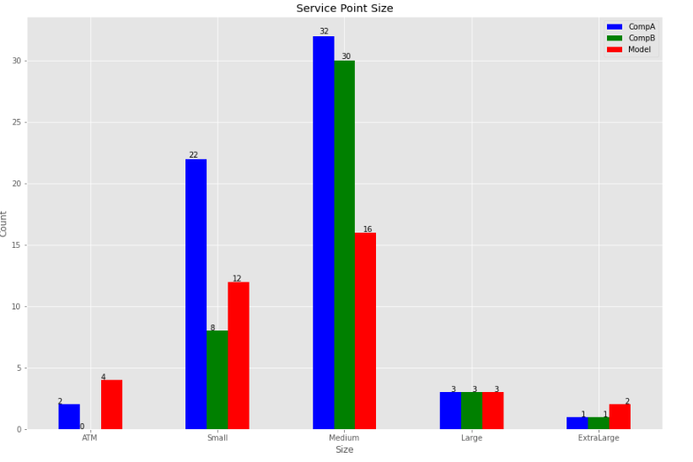
Service Point Size
Service Point Size | Customers Serviced Group | CompA |  | CompB |  | Model
 |  | N | % | N | % | N | %
ATM | Under 500 | 2 | 3,33% | 0 | 0,00% | 4 | 10,81%
Small | 500 - 2.000 | 22 | 36,67% | 8 | 19,05% | 12 | 32,43%
Medium | 2.000 - 10.000 | 32 | 53,33% | 30 | 71,43% | 16 | 43,24%
Large | 10.000 - 20.000 | 3 | 5,00% | 3 | 7,14% | 3 | 8,11%
Extra Large | Over 20.000 | 1 | 1,67% | 1 | 2,38% | 2 | 5,41%
Total Service Points |  | 60 | 100% | 42 | 100% | 37 | 100%

Slide 16
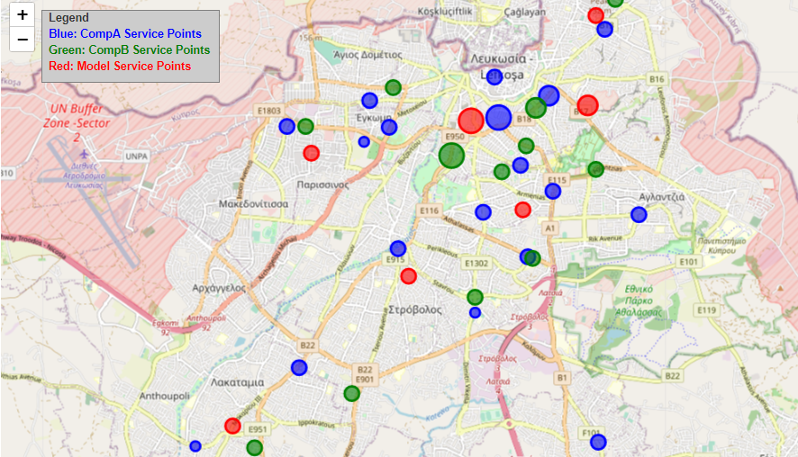
Service Point Spatial Distribution with Size
Nicosia, Cyprus

Slide 17
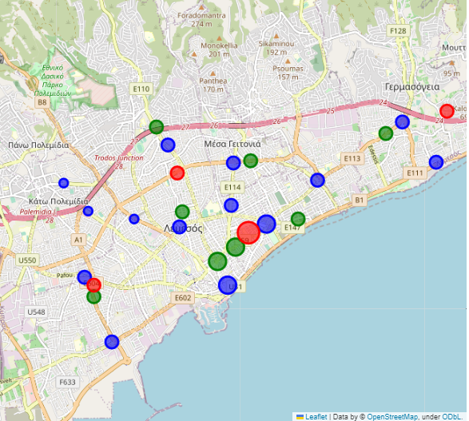
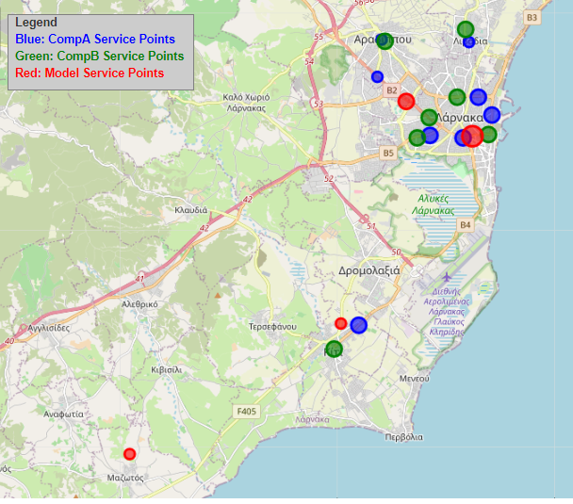
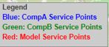
Service Point Spatial Distribution with Size
Limassol, Cyprus
Larnaca, Cyprus

Slide 18
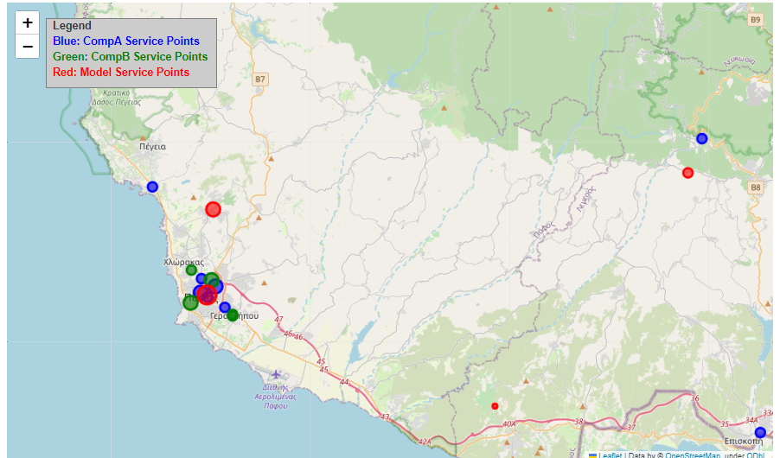
Service Point Spatial Distribution with Size
Paphos, Cyprus

Slide 19
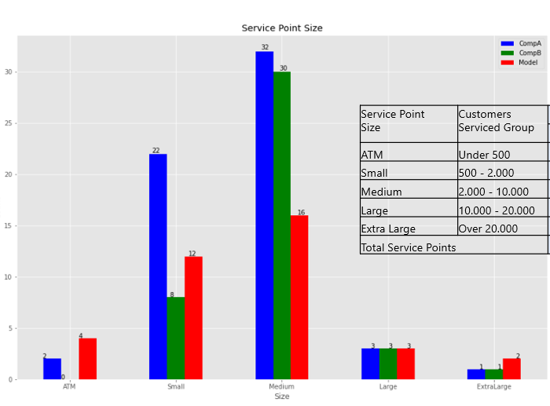
Service Point Placement By Customer Geolocation Clustering
Revenue increase through proposed reduced operating cost of service points
Minimized distance to service points
Improved customer experience through calculated service point size

Slide 20
Service Point Placement By Customer Geolocation Clustering
Location, Location, Location
When Distance, Distance, Distance Matters
https://github.com/consmalekkou/Service-Point-Placement-By-Customer-Geo-Location-Clustering
constantia.malekkou@gmail.com

